Slide 1
Create a Matrix Report
Lecturer: Ngo Huy Bien
Software Engineering Department
Faculty of Information Technology
VNUHCM - University of Science
Ho Chi Minh City, Vietnam
nhbien@fit.hcmus.edu.vn

Slide 2

Objectives

Slide 3

Contents

Slide 4

References
Brian Larson (2017). Microsoft SQL Server 2016 Reporting Services. McGraw-Hill Education.

Slide 5
Data Regions
The tablix, when functioning like a table, starts with a predefined number of columns.
It then adds a data row to the resulting report for each record in the dataset.
The tablix is one of a number of special report items designed specifically for working with datasets. These special report items are called data regions.
The other data regions are the chart, the gauge, the map, and the sparkline.

Slide 6
How Data Regions Work
Data regions are able to work with multiple records from a dataset.
The data region reads a record from the dataset, creates a portion of the report using the data found in that record, and then moves on to the next record.
It does this until all the records from the dataset have been processed.
The tablix creates mainly textual layout for each record in the dataset.
The chart, gauge, sparkline, and map data regions create mainly graphical layout for the records in the dataset.

Slide 7
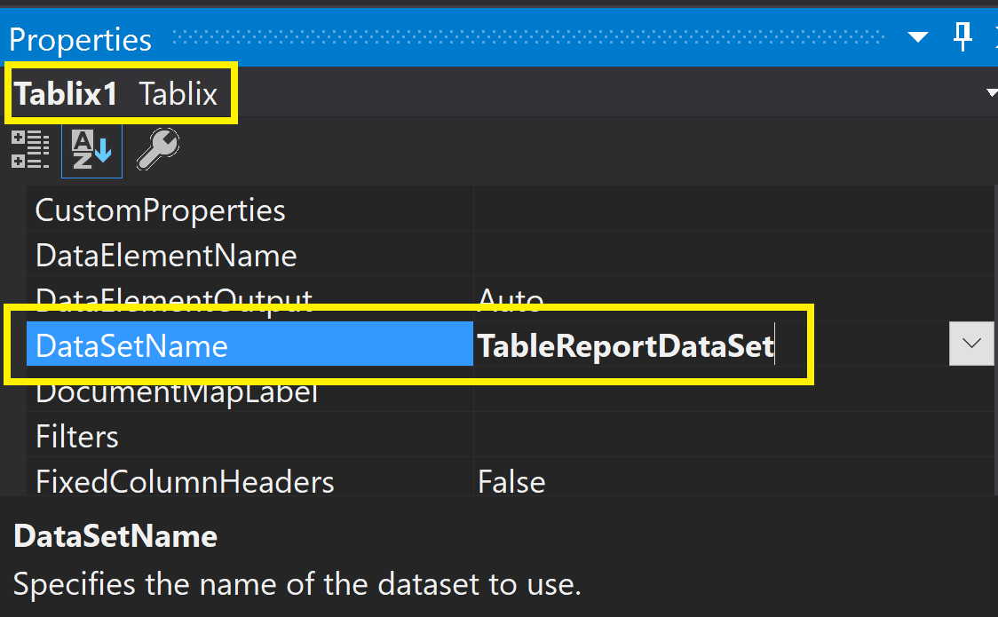
DataSetName
Each data region item has a property called DataSetName.
This property contains the name of the dataset used by the data region.

Slide 8


Slide 9
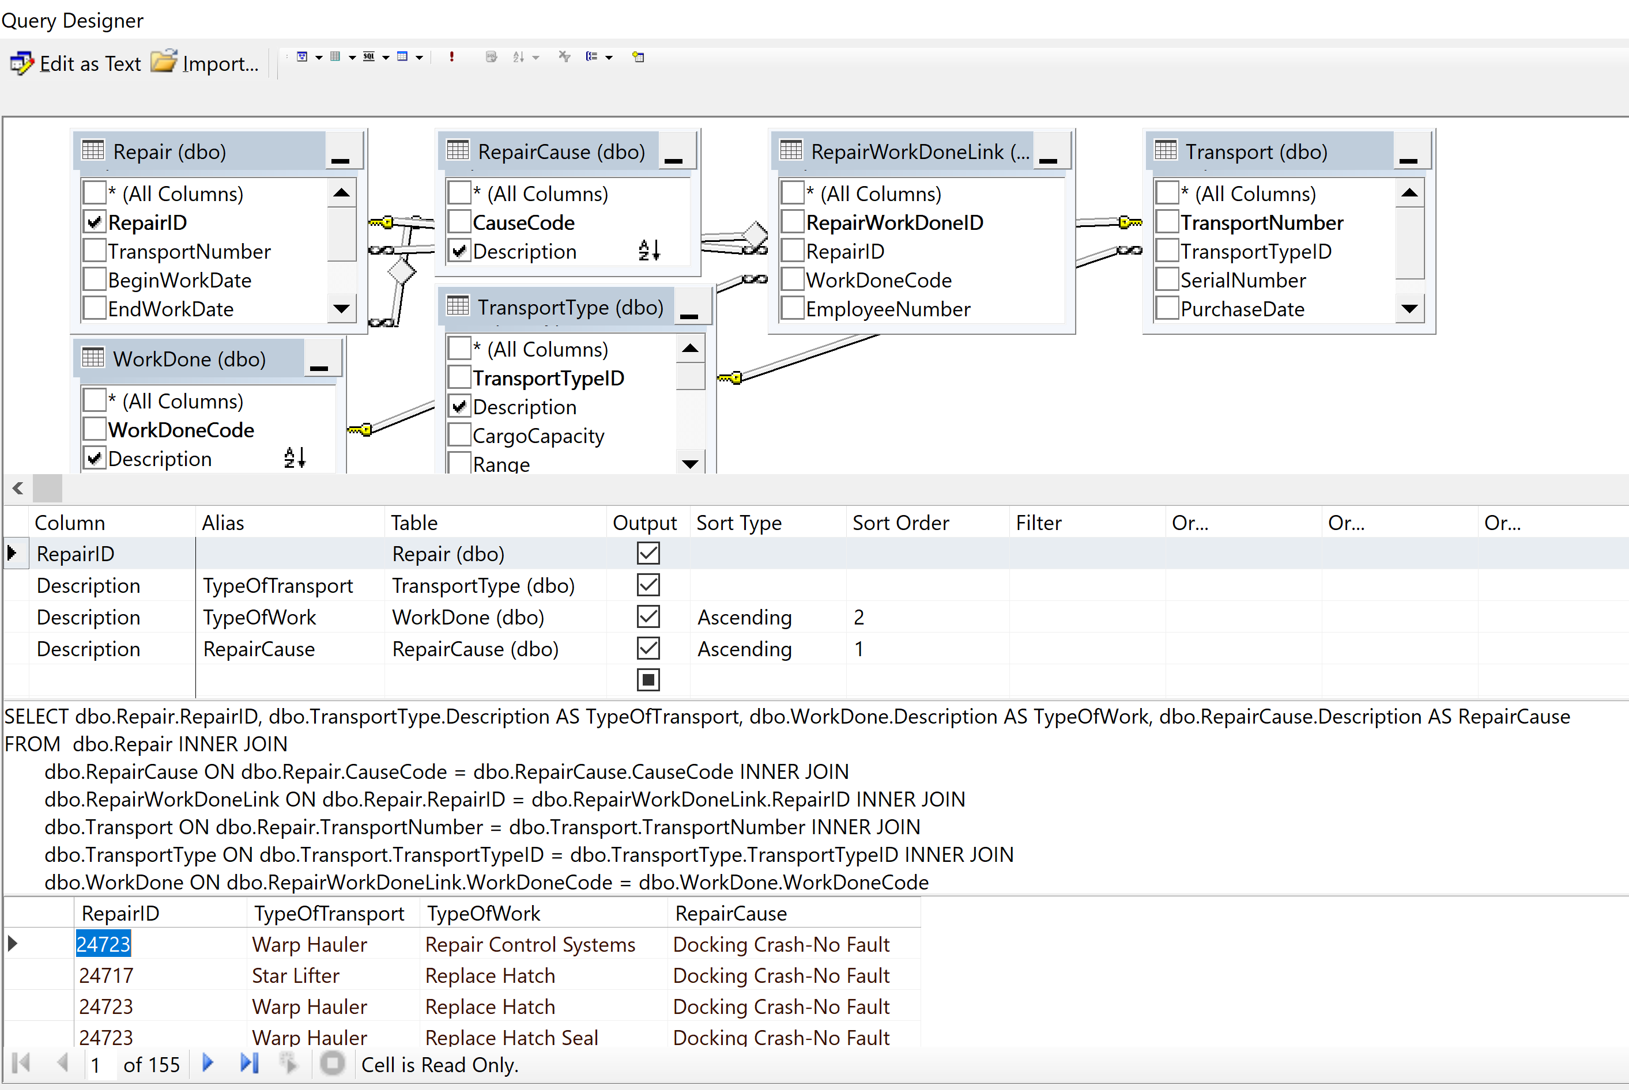
1. Create a Data Set (I)

Slide 10
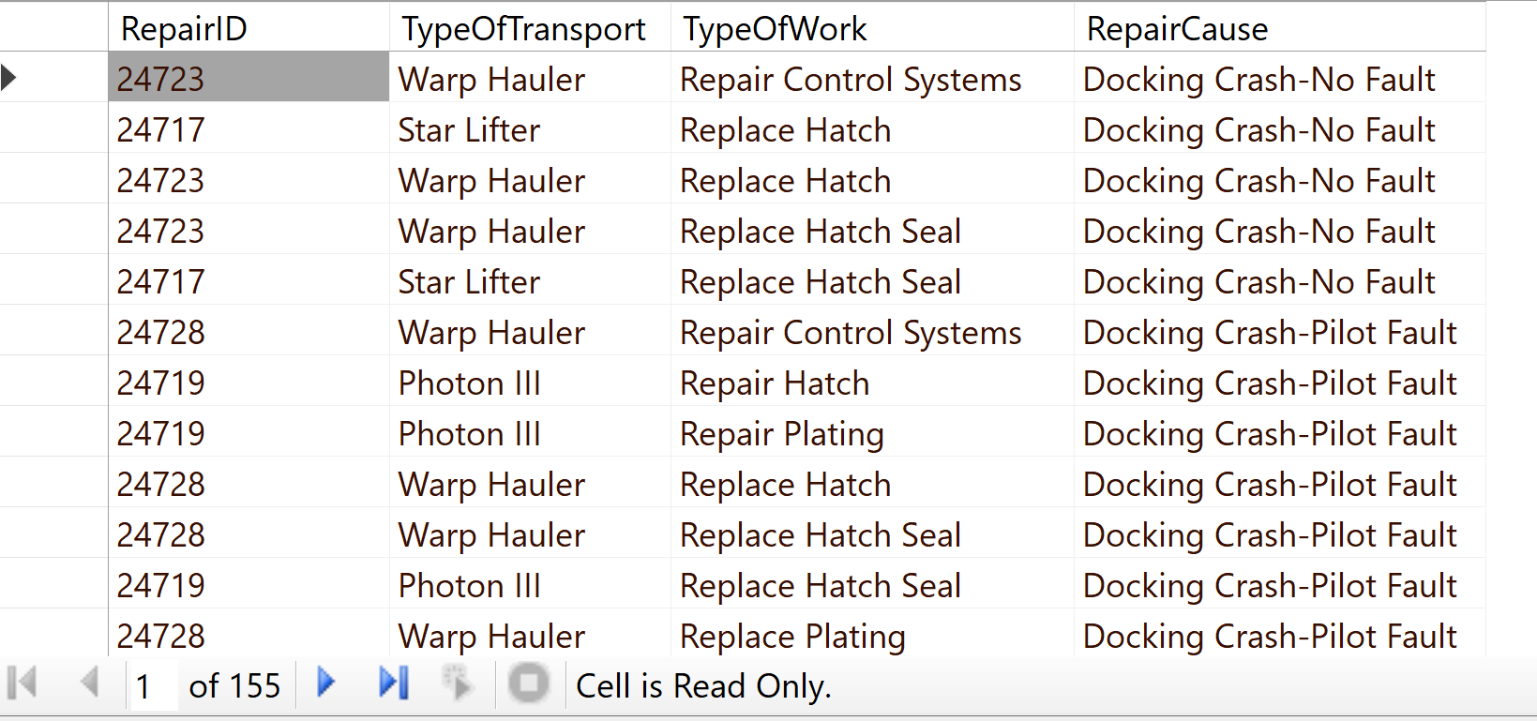
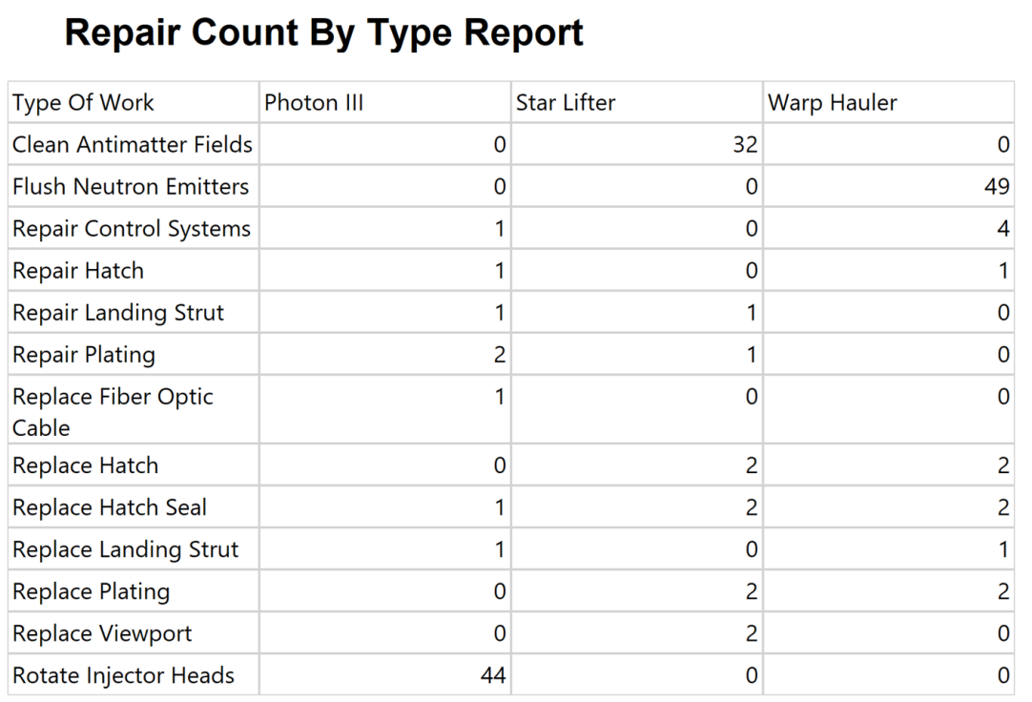
2. Create a Data Set (II)
We shall count the number of RepairID for combination of TypeOfTransport and TypeOfWork.
The count meaning is important for understanding how matrix report works.

Slide 11
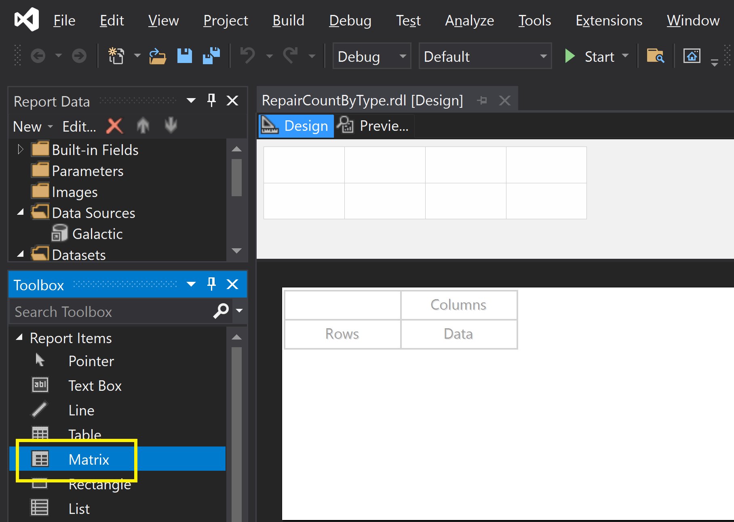
3. Add a Matrix

Slide 12
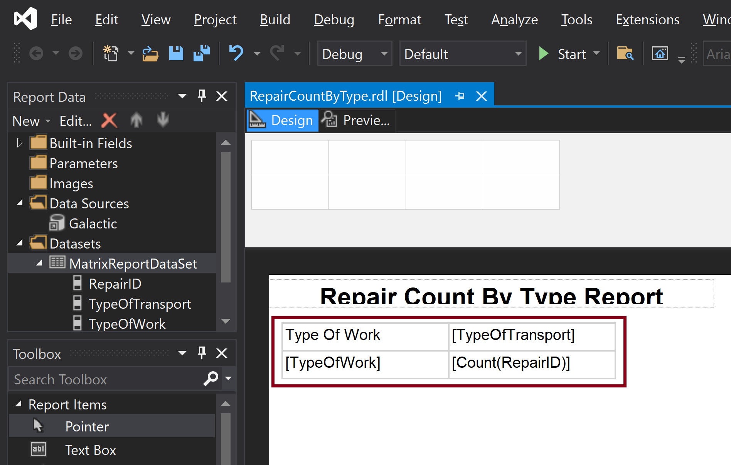
4. Select Data for the Matrix

Slide 13
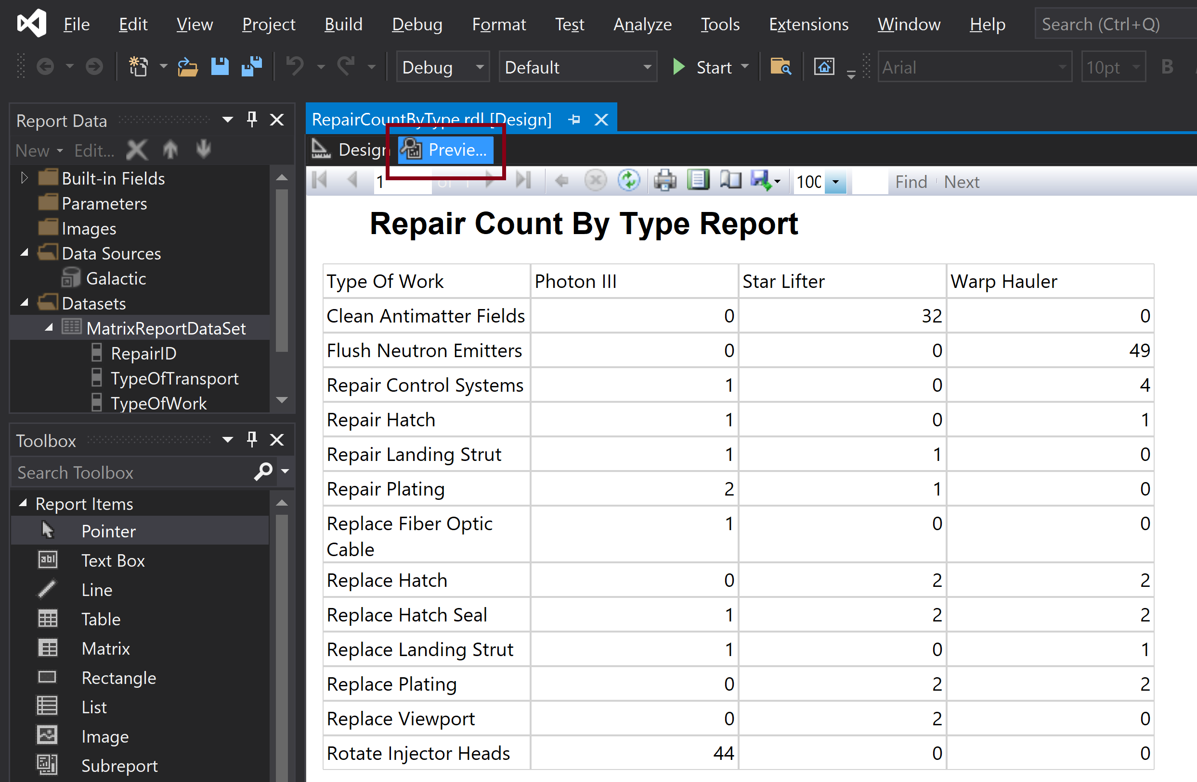
5. Preview the Matrix

Slide 14
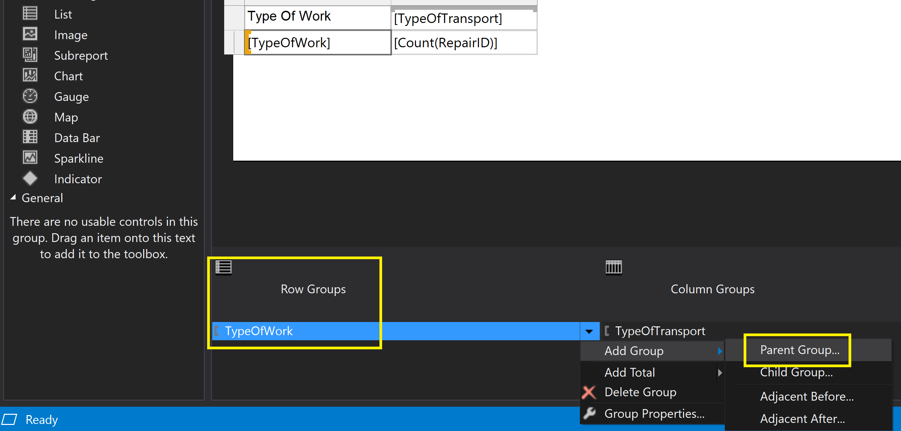
6. Create a Row Group
In the Row Groups area of the Grouping pane, click the drop-down arrow, and select Add Group | Parent Group from the menu.

Slide 15
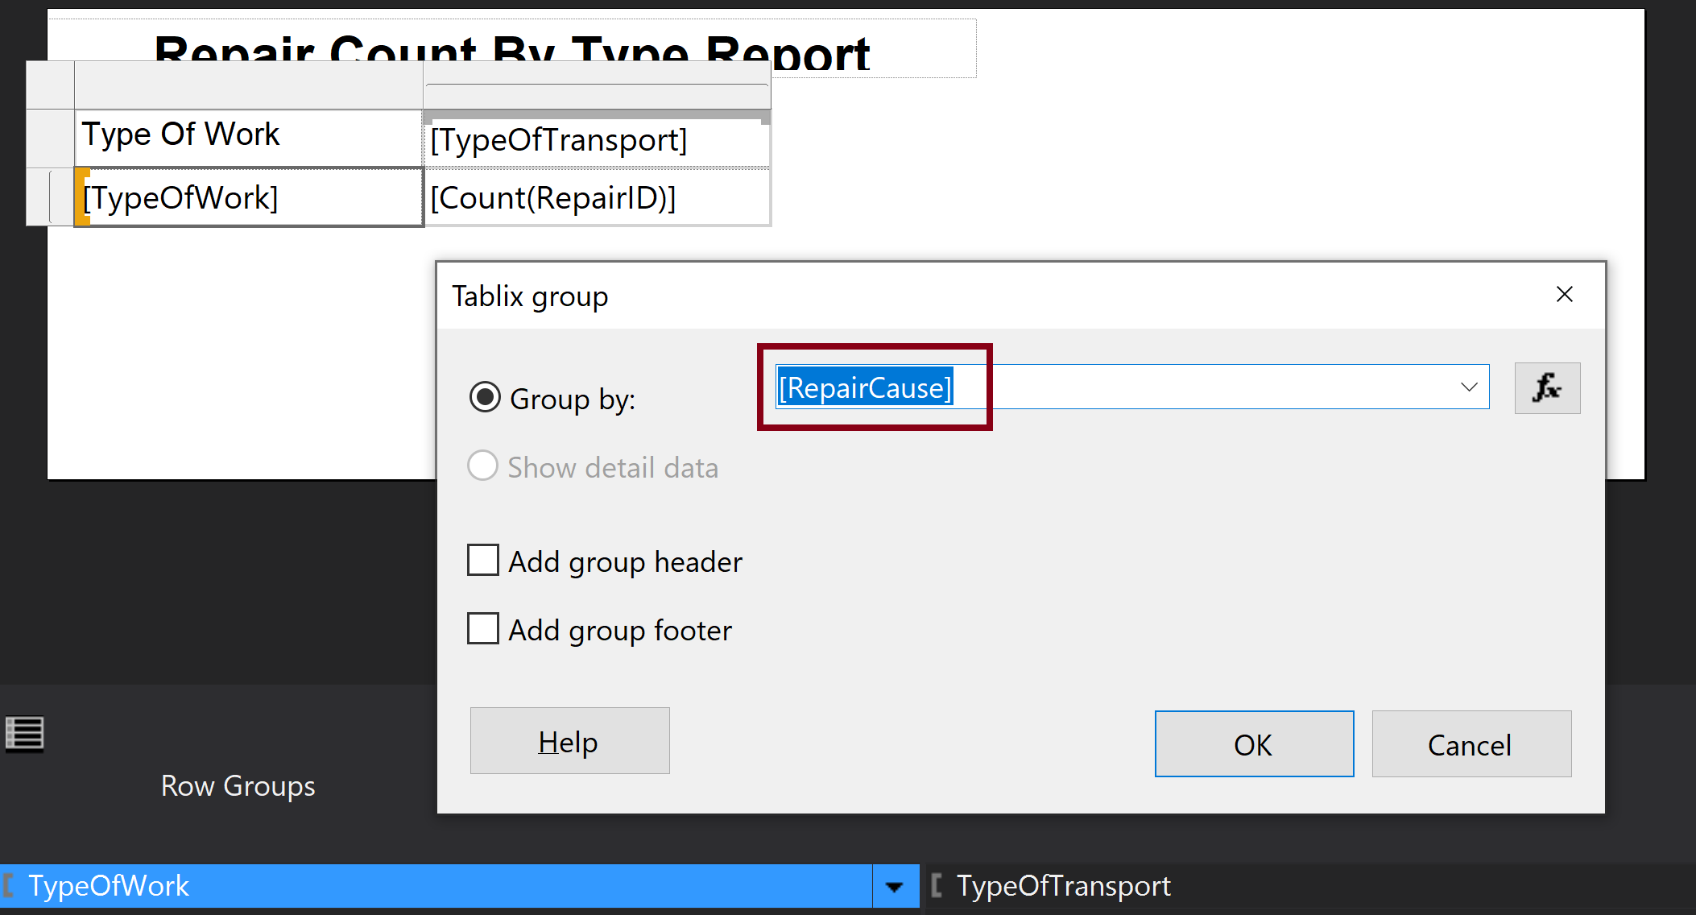
7. Select a Column for Grouping Rows

Slide 16
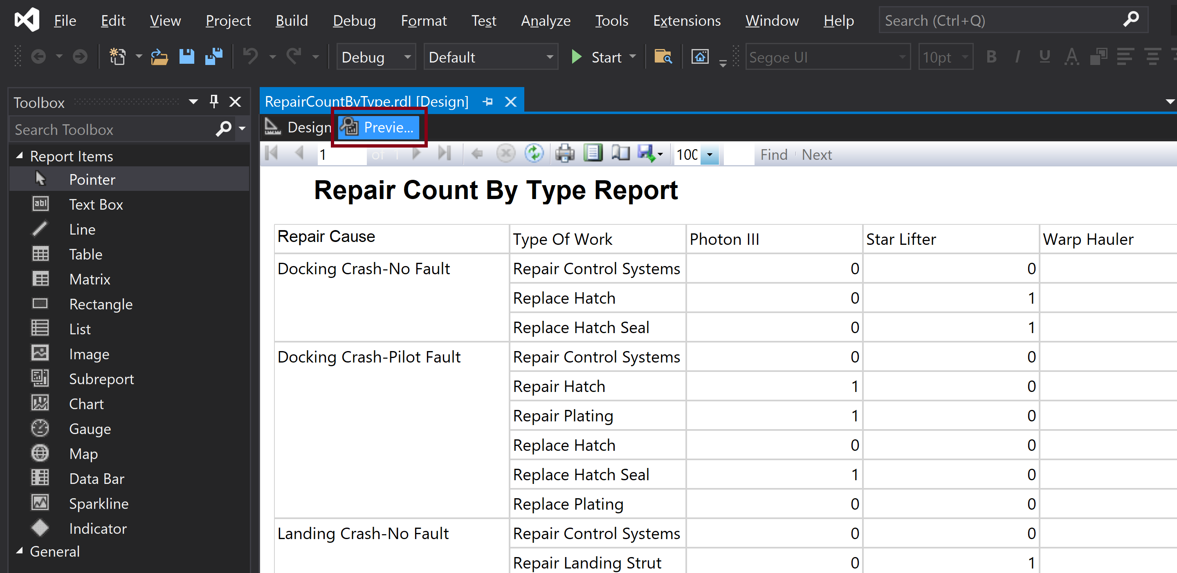
8. Preview the Matrix

Slide 17
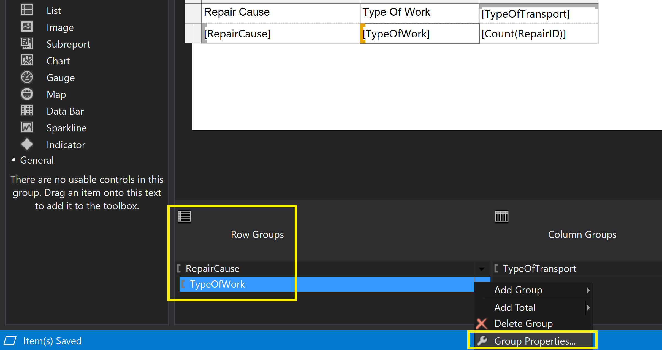
9. Open Row Group Properties
In the Row Groups area, right-click the TypeOfWork entry, and select Group Properties from the context menu.

Slide 18
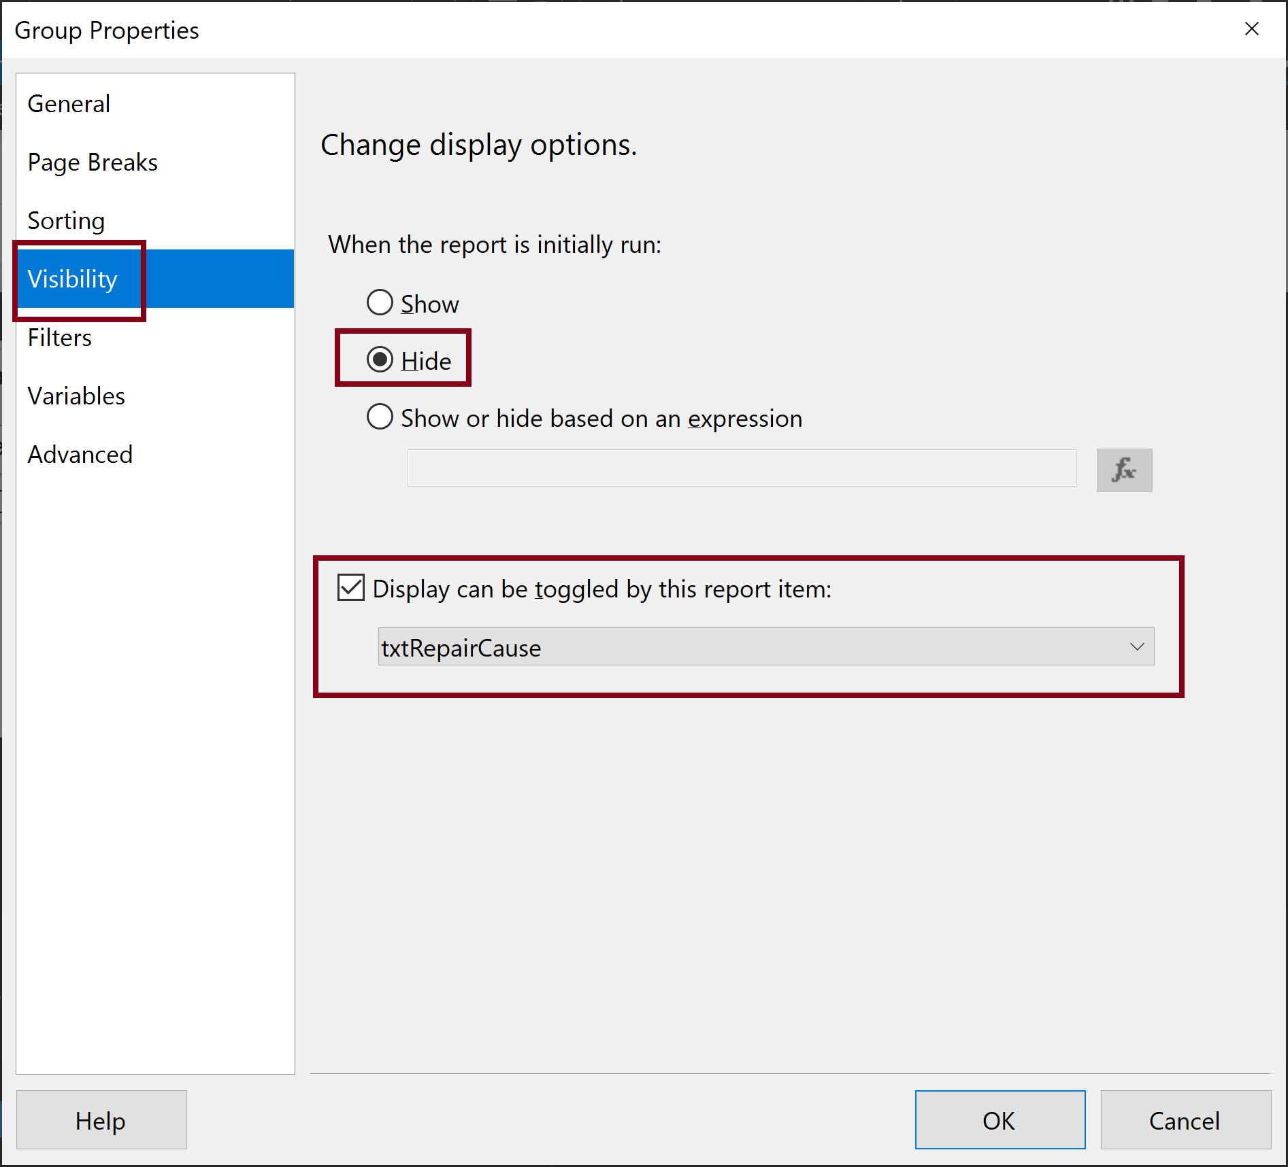
10. Modify Group Visibility

Slide 19
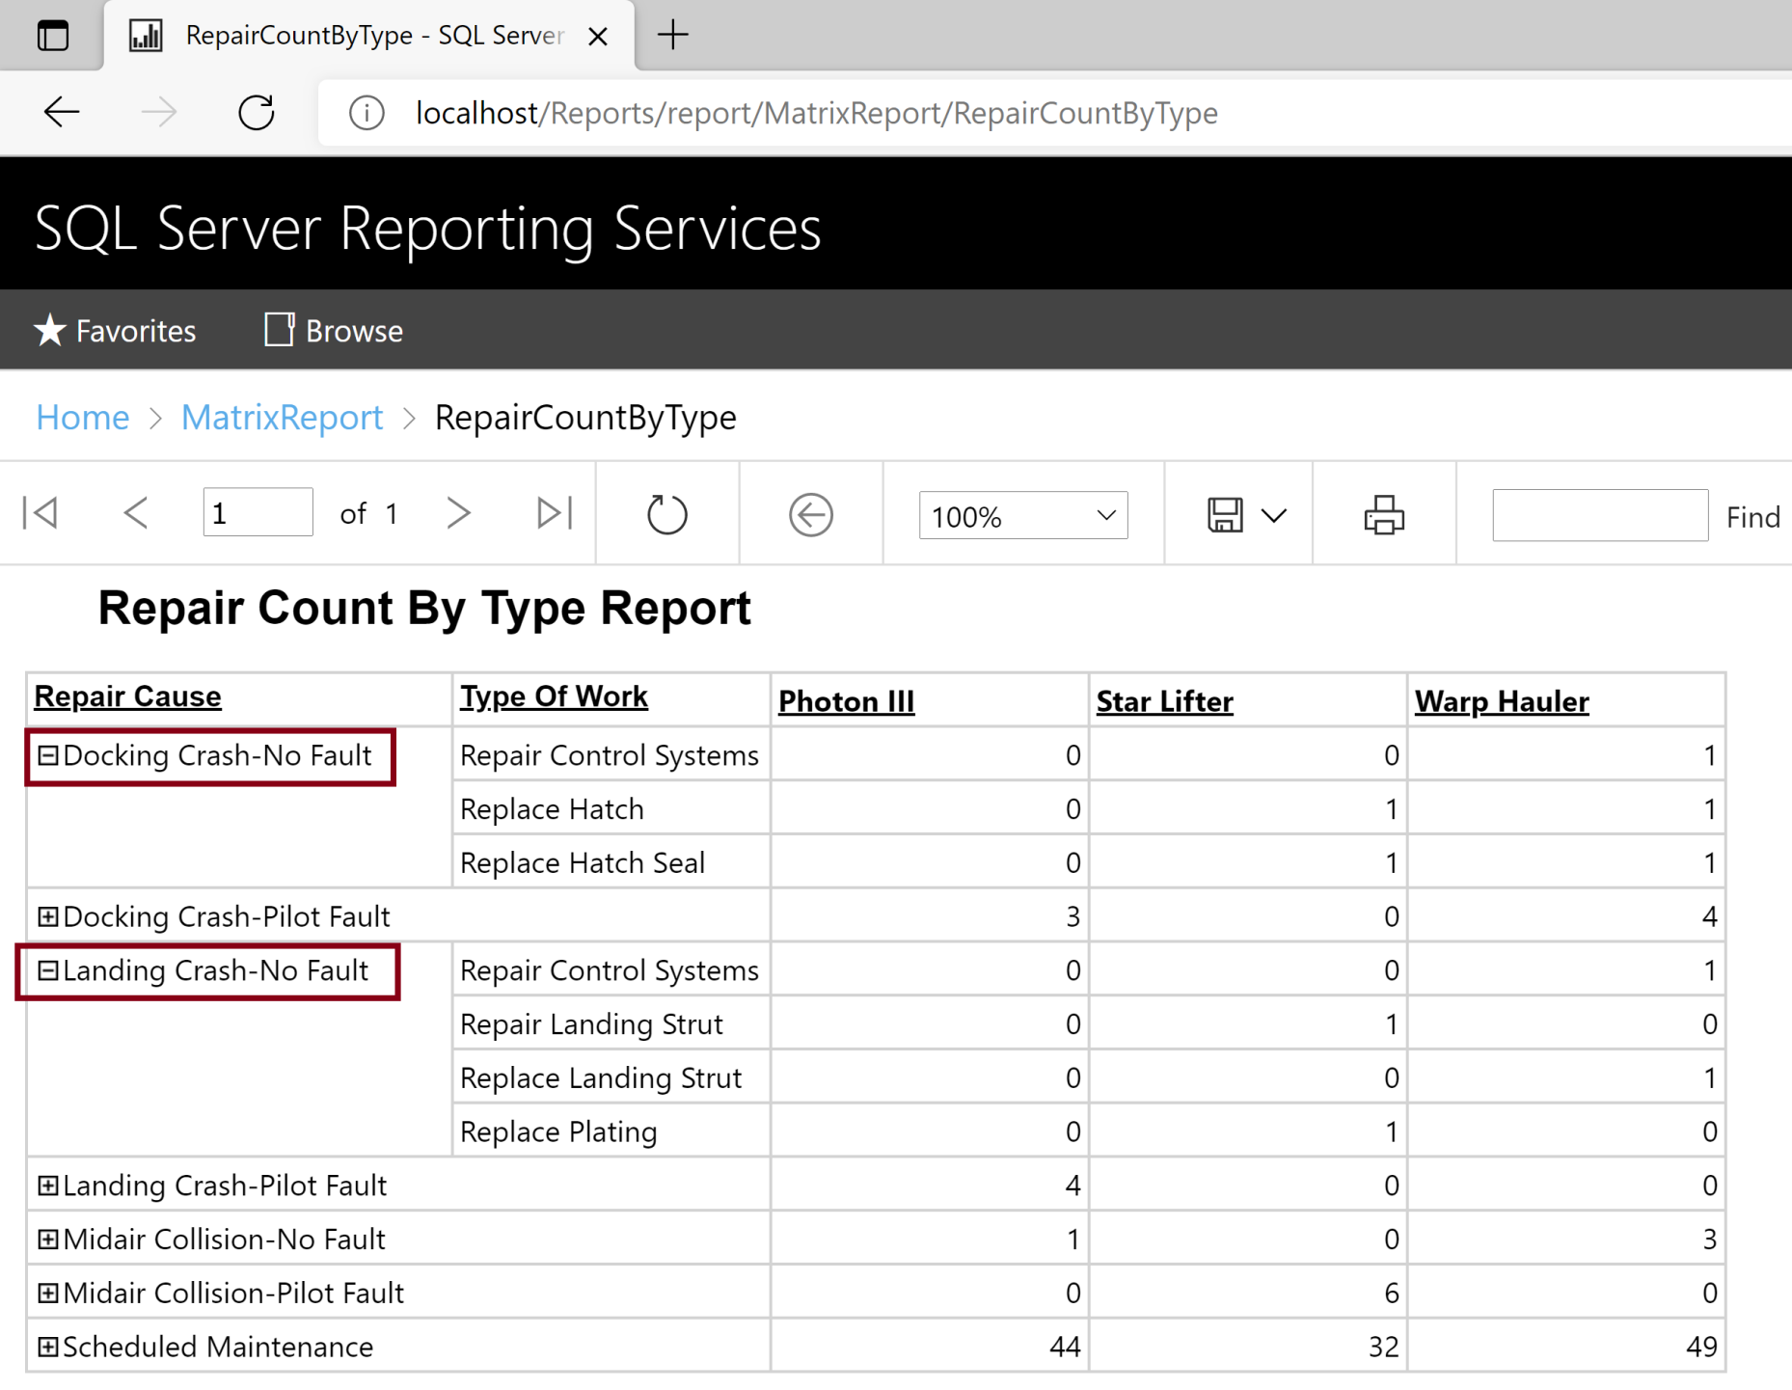
11. Test the Deployed Report
http://localhost/Reports/report/MatrixReport/RepairCountByType
Click

Slide 20

Thank You & See You Again

